Slide 1
Magic Wand Protype
John Usher
18-Feb-22

Slide 2
EXTERNAL
Cross-section should be triangle here!
End view:
Top Down view:
Large end view:
Side view:

Slide 3
INTERNAL
End view:
Top Down view:
speaker
LED
IMU
PLED
Large end view:
100 x 45 x 21mm
Side view:
speaker
button
IMU
PLED
Loudspeaker drivers face down into air gap (5 mm)

Slide 4
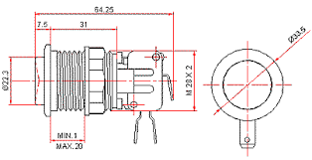
Arcade button:
We need an LED near here: ideally a plastic ring around the LED that acts as a light diffuser.
The LED will be a standard LED package

Slide 5
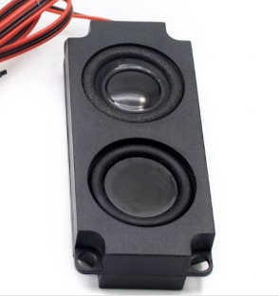
loudspeaker
https://www.berrybase.de/raspberry-pi/raspberry-pi-computer/displays/8-ohm-5w-lautsprecher-passend-f-252-r-waveshare-displays?sPartner=g_shopping&gclid=Cj0KCQiApL2QBhC8ARIsAGMm-KH6kq9ZmpYTb-jLkTrJjl6RPikgvAl0aNnh8y3iC_yK5_bUrXXG-RcaAvE0EALw_wcB&c=56
100 x 45 x 21mm

Slide 6
IMU

